Slide 1
CAPSTONE PROJECT PHASE-1
Review -1
Sustainable Precision Agriculture via Disease Localization and Optimized Treatment Pathways
Prepared by : J Krithika, 220111046
Jumana, 22011101047
4th year, Artificial Intelligence and Data Science
Shiv Nadar University, Chennai
Mentored By : Dr. Veeramani Sonai
Associate Professor, Computer Science and Engineering
Shiv Nadar University, Chennai

Slide 2
Problem Description
Modern agriculture faces the dual challenge of maximizing crop yield while minimizing environmental damage. Traditional approaches to managing plant diseases often involve blanket pesticide spraying across entire fields, regardless of whether all areas are actually infected. This leads to excessive chemical usage, increased operational costs, and environmental harm due to chemical runoff.
The "Sustainable Precision Agriculture via Disease Localization and Optimized Treatment Pathways" project aims to solve this problem by introducing a targeted approach to disease management in agricultural fields. By leveraging geospatial data (such as Sentinel-2 satellite imagery) and deep learning techniques, the system detects and segments diseased regions within a field. These zones are then geolocated, and an optimized spraying route is calculated using graph-based algorithms.
The system ensures that treatment is applied only where necessary, minimizing chemical usage while maximizing operational efficiency. This approach supports sustainable farming practices, reduces input costs, and promotes environmental safety, making it highly relevant for modern precision agriculture.

Slide 3





Significance
Environmental Sustainability
Improved Crop Health and Yield
Reduces overuse of pesticides by targeting only diseased zones.
Minimizes chemical runoff into soil and water bodies.
Supports eco-friendly farming practices and aligns with global sustainability goals.
Early and targeted disease detection enables timely intervention.
Promotes overall plant health and enhances productivity.
Cost Efficiency
Lowers pesticide usage, reducing input costs for farmers.
Optimized spray routes cut fuel and labor costs by minimizing machine traversal.
Scalable and Adaptable Solution
AI-Powered Decision Making
Integrates deep learning and geospatial analysis for intelligent disease detection.
Replaces manual scouting, saving time and ensuring consistency across large fields.
Applicable to various crop types and regions using satellite or UAV imagery.
Adaptable to multiple geospatial data sources, making it globally deployable.

Slide 4
Literature Survey
Automated Plant Disease Detection via Remote Sensing
Systematic reviews highlight AI and image‐processing methods for plant disease detection using remote sensing and UAV imagery.
Dataset used : PlantVilage
Models used : LeNet, AlexNet, VGG16/19, ResNet50, Xception, SqueezeNet and EfficientNet, SVM, Random Forest, Decision Trees, kNN.
Deep Learning on Satellite Imagery for Crop Analysis
Surveys deep learning models applied to satellite imagery.
Shows four input “data shapes” used in agriculture: a single pixel (Type P), a temporal pixel sequence (T), a single 2D image (S) or a spatio-temporal image series (ST). Each shape can be interpreted in different ways for modeling.
UAV–AI Integration for Targeted Disease Detection
The authors systematically analyze how UAV models (types of drones), sensor payloads (cameras, scanners), and computational methods (ML/DL algorithms) are used for targeted disease detection, weed management, and pest control.
Emphasizes scalability, precision, and operational efficiency.
Graph-Based Route Optimization for Precision Spraying (SprayCraft)
SprayCraft framework models infected hotspots as graph nodes.
Uses graph algorithms(GNN) to compute near-optimal traversal paths for targeted spraying.

Slide 5
Overview of Technology Stack
Satellite Source: Google Earth Engine API (Sentinel-2).
Training Data: Synthetic samples with realistic disease patterns.
Multi-Modal Architecture combining satellite, spectral, and weather data.
Graph algorithms for optimized spraying paths.
Geographic Information System and mapping tools for visualization.

Slide 6
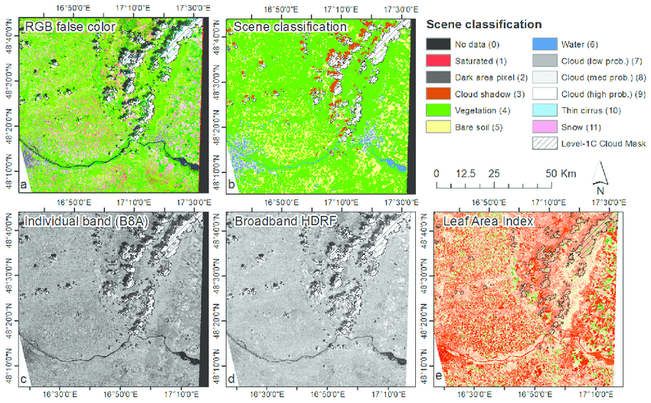
How is sentinel Imagery used?
Red and Near-Infrared (NIR) Bands: Healthy vegetation strongly absorbs red light for photosynthesis and reflects near-infrared light. By comparing the reflectance values of these two bands, we can calculate vegetation indices like the NDVI, which is a powerful indicator of plant health, density, and growth stage
Red-Edge Bands: Sentinel-2 having "red-edge" bands, which are particularly sensitive to changes in chlorophyll content. These bands are crucial for the early detection of crop stress and diseases.
B4 (Red, 665 nm): Sensitive to chlorophyll absorption.
B8 (NIR, 842 nm): Sensitive to cell structure in leaves.
B5/B6/B7 (Red-edge, 705–783 nm): Detects changes
in chlorophyll concentration before they’re visible in RGB.
B11/B12 (SWIR, 1610–2190 nm): Sensitive to moisture
content and stress.

Slide 7
Expected Outcomes
Automated Disease Detection
Identifies healthy vs. diseased zones from Sentinel‑2 imagery.
Generates heatmaps of infected regions.
Optimal Routing Plan
Calculates shortest spraying paths within affected fields.
Minimizes travel cost, time, and pesticide usage.
Interactive Dashboard
Maps infected areas with visual overlays.
Displays optimized spraying routes and navigation steps.
Scalable & Adaptable Solution
Applicable to diverse crops and regions
Works with any geospatial dataset (satellite/drone imagery).

Slide 8
References
Revolutionizing agriculture with artificial intelligence: plant disease detection methods, applications, and their limitations
Zhang, H., et al. (2023). Deep learning for satellite-based crop monitoring and disease analysis. arXiv preprint, arXiv:2210.01272.
Torres-Sánchez, J., et al. (2024). UAV and AI integration for precision agriculture: A systematic review. ScienceDirect.
Xie, Q., et al. (2024). SprayCraft: Graph-based route optimization for targeted pesticide application. arXiv preprint, arXiv:2412.12176.
https://arxiv.org/abs/2310.18268

Slide 9
ThankYou

Slide 10
What “Physics-Informed” Means Here
We simulate how plant disease affects reflectance based on:
Light absorption by chlorophyll & pigments.
Changes in leaf structure & water content.
How these changes appear in Sentinel-2’s bands.
This is guided by:
Radiative transfer models (like PROSAIL).
Published spectral signatures of diseased crops.
Field-level knowledge from plant pathology.
b. How It’s Done
Start with healthy Sentinel-2 imagery of fields.
Apply spectral shifts in bands to mimic:
Lower NIR reflectance (less cell structure).
Higher red reflectance (less chlorophyll).
Altered red-edge slope (stress marker).
Adjust vegetation indices accordingly.
Add noise and variability to make them realistic (different severity levels, weather effects).
Label these synthetic samples as “stressed” or “diseased” and merge with the real dataset.

Slide 11
How can a disease be simulated
Pick a healthy image – Take a clean Sentinel-2 image of the field when crops are healthy.
Decide disease effects – How the disease changes plants: less chlorophyll, less water, more brown spots, shifts in red-edge. Choose mild, moderate, or severe.
Use a model – Feed these changes into a plant-light model (like PROSAIL) to get reflectance values.
Simulate over time – Model how the disease appears and spreads over days/weeks.
Add variety – Change soil background, sunlight angle, crop stage, and sensor noise for diversity.
Match Sentinel-2 – Convert the simulated values to Sentinel-2 bands.
Add realism – Include atmosphere effects, clouds, and sensor noise.
Attach weather & labels – Add matching weather data and tags like disease type, severity, date.
Save in usable format – Store the dataset in the same file type as your real data.

